Slide 1
Big Data Solutions in GCP
Overview

Slide 2
Contents
Analytics Data Warehouse – Big Query
Batch and Stream Data Processing – DataFlow
Managed Hadoop & Spark – Dataproc
Workflow Orchestration – Composer
Data Exploration – Datalab
Dashboards and reports – Data Studio
Intelligent Data Preparation – Dataprep
Scalable event ingestion & messaging middleware – Pub/Sub

Slide 3
Recap
Big data is a term used to refer to the study and applications of data sets that are too complex for traditional data-processing application software to adequately deal with.
Big data challenges include capturing data, data storage, data analysis, search, sharing, transfer, visualization, querying, updating, information privacy and data source.

Slide 4
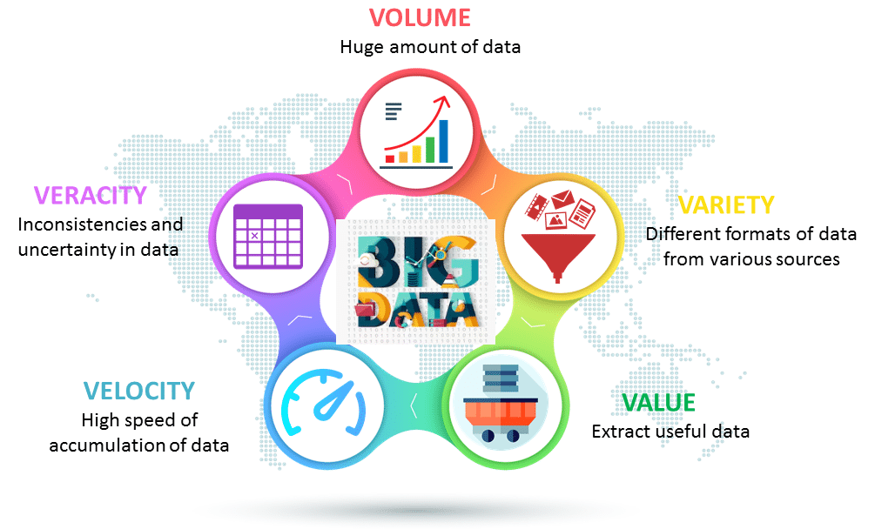
Big data was originally associated with three key concepts – 3Vs: volume, variety, and velocity.
Other concepts later attributed with big data are veracity (i.e., how much noise is in the data) and value.

Slide 5
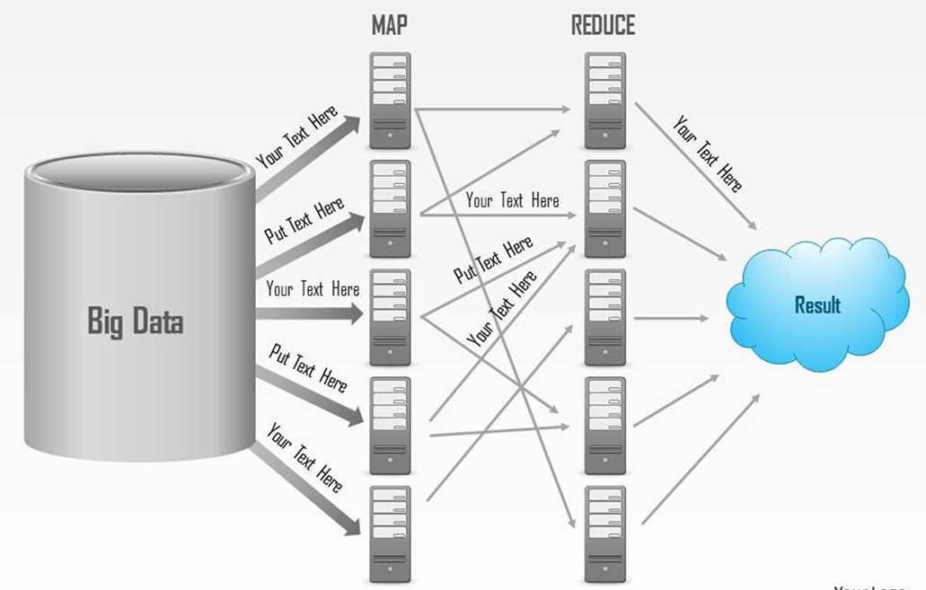
Recap
MapReduce: MapReduce is a programming model and an associated implementation for processing and generating big data sets with a parallel, distributed algorithm on a cluster. Refer illustration.

Slide 6
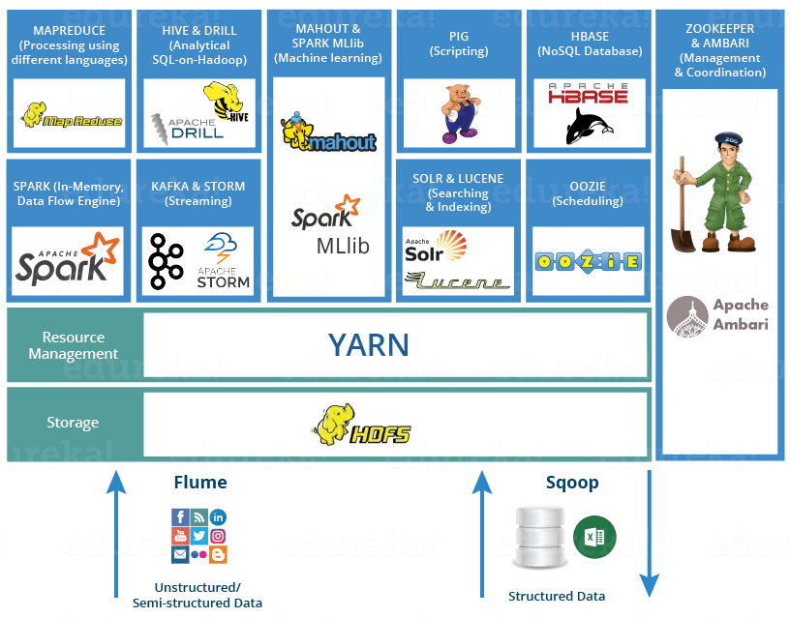
Recap
Hadoop: Hadoop is an open source distributed processing framework that manages data processing and storage for big data applications running in clustered systems
Hadoop ecosystem: Suite of tools which encompasses a number of services (ingesting, storing, analyzing and maintaining)

Slide 7
Recap
HDFS -> Hadoop Distributed File System
YARN -> Yet Another Resource Negotiator
MapReduce -> Data processing using programming
Spark -> In-memory Data Processing
PIG, HIVE-> Data Processing Services using Query (SQL-like)
HBase -> NoSQL Database
…
…
Others: Mahout, Spark MLlib (Machine Learning), Apache Drill (SQL on Hadoop), Zookeeper (Managing Cluster), Oozie (Job Scheduling), Flume, Sqoop (Data Ingesting Services), Solr & Lucene (Searching & Indexing), Ambari (Provision, Monitor and Maintain cluster)

Slide 8
Big Data services in Google Cloud Platform
With Google Cloud Platform you can focus on finding insights rather than managing your infrastructure and you can combine cloud-native services with open source tools as needed, both in batch and stream mode.

Slide 9
Google BigQuery
Google BigQuery is Google's fully managed, low cost analytics data warehouse.
BigQuery is serverless, there is no infrastructure to manage, no need to guess the needed capacity or overprovision, and you don't need a database administrator.
You can focus on analyzing data to find meaningful insights, use familiar SQL, and take advantage of the pay-as-you-go model.
BigQuery is a powerful Big Data analytics platform used by all types of organizations, from startups to Fortune 500 companies.

Slide 10
Google Cloud DataFlow
Google Cloud Dataflow offers a unified programming model and a managed service for executing a wide range of data processing patterns including streaming analytics, ETL, and batch computation.
Cloud Dataflow frees you from operational tasks like capacity planning, resource management and performance optimization.

Slide 11
Google Cloud Dataproc
Use Google Cloud Dataproc, a managed Spark and Hadoop service, to easily process big datasets using the powerful and open tools in the Apache big data ecosystem.
Control your costs by creating managed clusters of any size in about a minute, and turning them off when you're done, paying for what you use, not idle clusters.
Cloud Dataproc integrates with storage, compute, and monitoring services across Cloud Platform products, giving you a powerful and complete data processing platform.

Slide 12
Google Cloud Composer
Google Cloud Composer is a fully managed workflow orchestration service that empowers you to author, schedule, and monitor pipelines that span across clouds and on-premises data centers.
Built on the popular Apache Airflow open source project and operated using the Python programming language, Cloud Composer is free from lock-in and easy to use

Slide 13
Google Cloud Datalab
Google Cloud Datalab is an interactive notebook (based on Jupyter) to explore, collaborate, analyze and visualize data.
It is integrated with BigQuery and Google Cloud Machine Learning to give you easy access to key data processing services.

Slide 14
Google Data Studio
Google Data Studio turns data into dashboards and reports that are easy to read, share, and customize.

Slide 15
Google Cloud Dataprep
Google Cloud Dataprep is an intelligent data service for visually exploring, cleaning, and preparing structured and unstructured data for analysis. Cloud Dataprep is serverless and works at any scale. There is no infrastructure to deploy or manage. Easy data preparation with clicks and no code.

Slide 16
Google Cloud Pub/Sub
Google Cloud Pub/Sub is a serverless, large scale, reliable, real-time messaging service that allows you to send and receive messages between independent applications.
You can leverage Cloud Pub/Sub’s flexibility to decouple systems and components hosted on Cloud Platform or elsewhere on the Internet.
By building on the same technology Google uses, Cloud Pub/Sub is designed to provide “at least once” delivery at low latency with on-demand scaling to tens of millions of messages per second.

Slide 18
Appendix

Slide 19
Introduction
BigQuery is Google cloud platform’s Data warehousing solution. Meant for big data Analytics that is lightning fast, processing and perfect full form in the data set. Behind task quotes. It is so less and scales asigali to over petabytes of storage. It is relatively cheap to store data over the real cost comes when you want to process the data. Query allowance for batch and streaming inserts where batches for free and streaming is not. Haynes only use streaming when absolutely necessary.
Overview. Slide.
Authorised reviews. Partition table sadvilkar tables. Dtc and standard SQL. How to reduce processing cost? Using existing public data sets to perform a standard Sequal query to create a new table. Add see the processing cost.
Equery offers Scilab is flexible pricing options to hell with your project budget. Kari charges for data storage streaming inserts and for querying data loading and exporting data are free of charge.
Giving a view access to a data set is also known as creating unauthorized view in Jquery.

